Slide 1
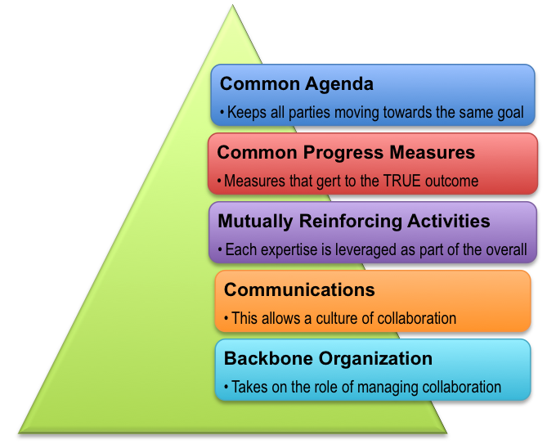
Healthy babies born and raised in safe and stable families and communities
Assessment
Partnerships
Collective impact model

Slide 2
Data analysis
Evidence-based initiatives
Breastfeeding promotion
Sustainability

Slide 3
More information:
443-777-7931
Healthybabies@medstar.net
http://www.medstarfranklinsquare.org/our-hospital/community-health-improvement/healthy-babies-collaborative-hbc/#q={}

