Slide 1
“Breath of Fresh Care”
Baltimore City Health Care Forum
Carmela Coyle
September 14, 2016

Slide 2
Health is About More Than Clinical Care
Health is driven by multiple factors that are intricately linked – of which medical care is one component.
Personal Behaviors
40%
Family History and Genetics
30%
Environmental
and Social
Factors
20%
10%
Medical
Care
Source: Determinants of Health and Their Contribution to Premature Death, JAMA

Slide 3
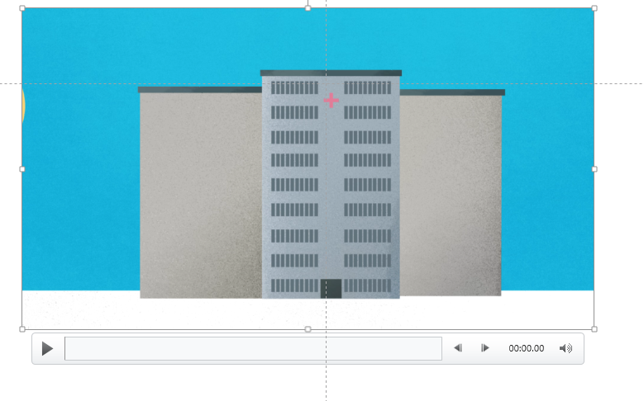
A Breath of Fresh Care
PATIENT BILL OF RIGHTS
AND
COMPLIMENTS & CONCERNS
COMMUNITY HEALTH PROGRAMS
FOR YOU
RESOURCES FOR PATIENTS
Thanks to a commitment by Maryland’s hospitals, in 2014 Maryland became one of the first states in the nation to implement a NEW proactive, community-based health care model. The vision: to help you get health and stay healthy for life.

Slide 4
“Breath of Fresh Care”
Baltimore City Health Care Forum 2016
Carmela Coyle
September 14, 2016

