Slide 1
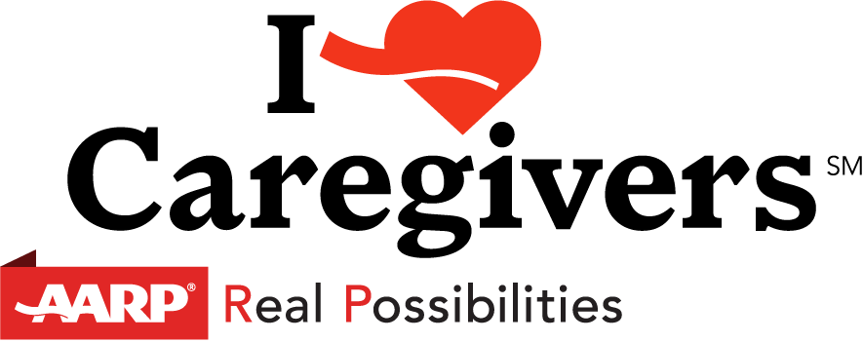
The Care Act

Slide 2
October 1, 2016
Notes:
The CARE Act was signed into law in Maryland goes into effect October 1, 2016.

Slide 3
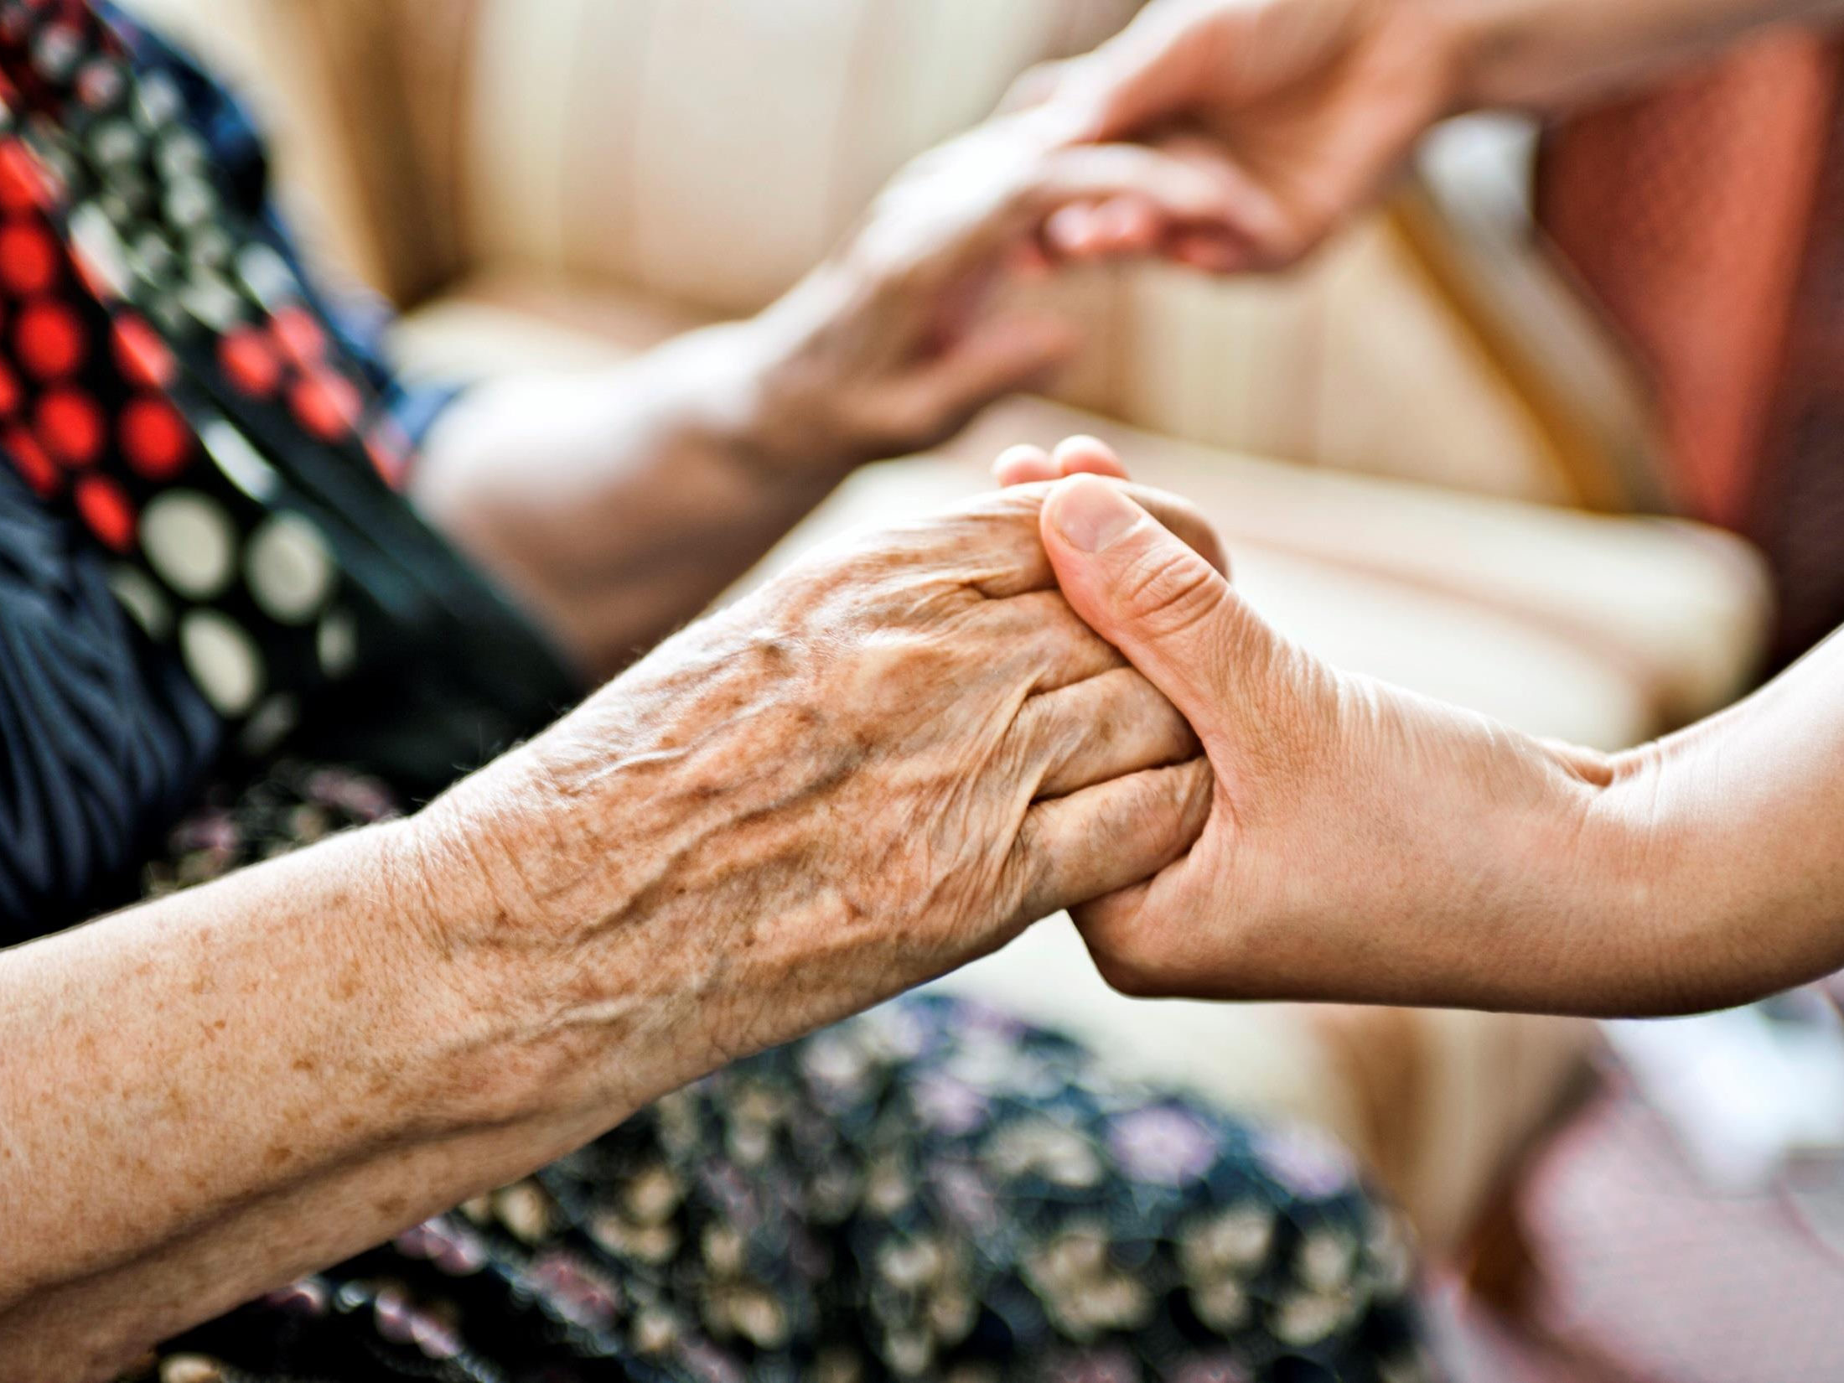
What is the Care Act?

Slide 4
The Care Act is a commonsense solution that supports family caregivers when their loved ones go into the hospital…
Notes:
The CARE Act is a commonsense solution that supports family caregivers when their loved ones go into the hospital,

Slide 5
…and as they transition home
Notes:
and provides for instruction on the medical tasks they will need to perform when their loved one returns home.

Slide 6
What does the Care Act do?

Slide 7
The Care Act requires hospitals to:
Provide your loved one the opportunity to designate a caregiver—such as family member, friend, or neighbor.
Inform you when your loved one is to be discharged to another facility or back home.
Consult with the caregiver on the medical tasks the caregiver will need to perform at home.

Slide 8
Why does Maryland
need the Care Act?

Slide 9
Family Caregiving in Maryland
771,000 family caregivers
Provide 615 million hours of unpaid care
Valued at about $ 9.3 billion a year
Notes:
Family caregiving is the new normal. Either we are a caregiver now, were one in the past, or will likely be one in the future.

Slide 10
The average family caregiver
49 year old woman caring for an older loved one
Works outside the home full or part-time
Provides 20 unpaid hours of care for her loved one each week
Cares for her loved one for nearly 5 years
Notes:
Who are family caregivers? Across the United States about 40 million unsung heroes care for parents, spouses, aunts, uncles, and other loved ones so they can live independently at home, where they want to be. The average caregiver is a 49 year old woman caring for an older loved one, usually her mother for nearly 5 years. In addition to caring for her loved one almost 20 hours a week, she works full or part-time outside the home.

Slide 11
Almost one-half of family caregivers
perform medical or nursing tasks…
Managing complex medication schedules
Bandaging and wound care
Tube feedings
Managing catheters
Giving injections
Operating medical equipment
Using sophisticated technology in the home
Notes:
Increasingly family caregivers are performing complex medical and nursing tasks to care for their loved ones once. Once only done by doctors and nurses these tasks include managing medication, wound care, giving injections, operating medical equipment, cleaning feeding tubes, and more. Today, about one-half of family caregivers perform complex medical tasks.

Slide 12
… without any training.
Most family caregivers report that they received little or no training to perform these tasks.

Slide 13
How can you help?
Help AARP in the fight for caregivers and their loved ones. Read and watch stories from people across the country, share your own story, and sign up for the latest news: aarp.org/iheartcaregivers
Notes:
Get involved through I Heart Caregivers. Your personal stories play a crucial role in our advocacy work. Stories like I shared with you early help us show the personal and emotional aspect of caregiving. So if you’re a family caregiver, or have been one in the past, we want to hear from you. Help us fight for you and your family by sharing your stories. You can do this by going to aarp.org/iheartcaregivers, or right now. [handout hard collection form]

Slide 14
If you are a family caregiver, you’re not alone.
To find the tools and support you need, as well as ways to connect with other caregivers, visit aarp.org/caregiving.
To stay up to date or to get involved with our caregiving advocacy in the states, visit aarp.org/supportcaregivers.

Slide 15
Thank you!
@AARPMD
facebook.com/aarpmd
aarp.org/md

