Slide 1
Envisioning a Maryland Faith Community Health Network to support improved coordination of care
Western Maryland Public Forum
April 2015

Slide 2
Context
Established at Methodist LeBonheur Hospital in Memphis, TN in 2006
Entered into covenant with local congregations
Notes:
Methodist LeBonheur is one of two hospitals in Memphis. They felt called to find a better way to treat people who were frequently coming into their emergency room. Doing a survey, they found that the vast majority of those folks attended church regularly.
They reached out to local faith leaders and shared this idea and a covenant was born. A group of faith leaders led a process to create this covenant agreement. In order to have a significant impact, they had a goal of engaging at least 20% of the market share through this model and aimed to get 400 congregations on board.

Slide 3
Congregational Health Network
Notes:
So what does the covenant mean? It means the hospital will hire a Navigator (purpule) to work with a liaison appointed by the congregation (red) when a CHN member is admitted to the hospital. When someone at a congregation joins the network, they sign what is essentially a HIPPA form that allows the hospital to ask if they would like ot have their congregation involved in their care at each admission When that member is admitted to the hospital, the Navigator meets with them everyday and coordinates with the liaison on a care plan so that the person’s care can continue even after discharge. The liaison can help with transportation, meals,

Slide 4
Notes:
Questions about quality—satisfaction with their time at the hospital—outstanding concerns or questions?
Home (homework, cooking, lawn care, pet care, daily call)
Church (bulletin, prayer chain)
Transportation (grocery, follow-up appt.)
Family (letters of encouragement, spiritual direction/counselling)
Medical (in-home visit, rx,)
Integrated into their electronic medical records (Sterner)

Slide 5
Congregational Health Network
Notes:
So what are the outcomes?
They had a goal of working with 400 and now are working with 600. Over 20,000 had signed up. And they have 9 navigators on board helping. Congregations are helping with their members—and others in their zipcodes. So they’re serving the community at large—not just those who are part of faith community.
Matched for demographic data including congregational membership. Shorter length of stay, readmisions and mortality rate, less charges and longer time to readmission.
They spend $600,000 from their Community Health Benefits and save ____

Slide 6
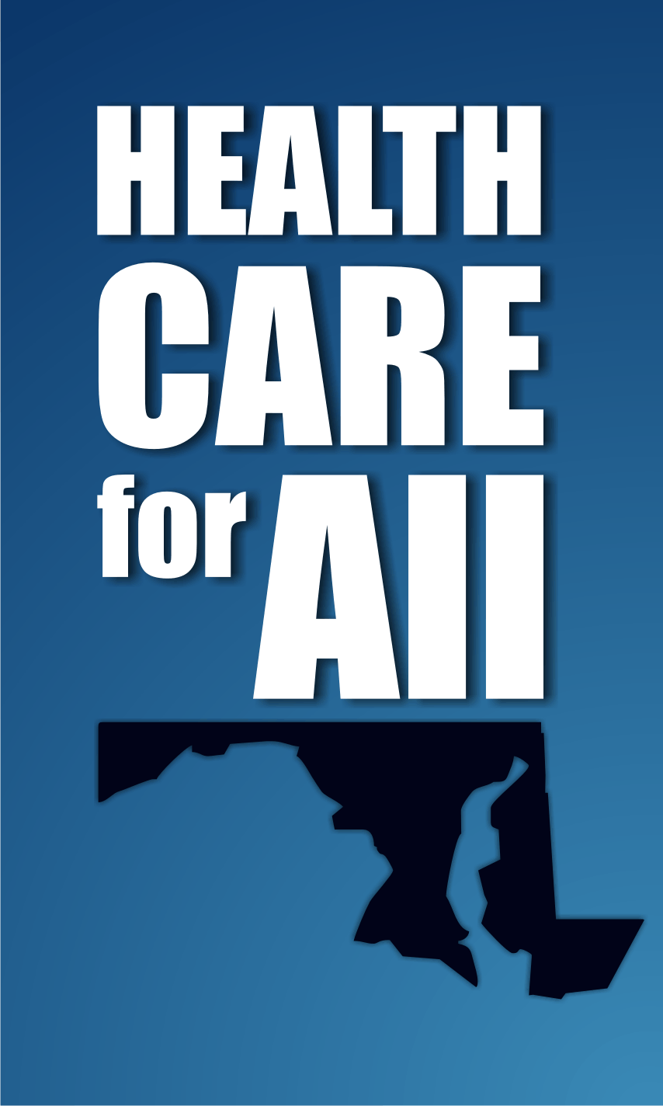
Thank you!
www.healthcareforall.com
(410)235-9000
Health Care for All!
2600 St. Paul Street
Baltimore, MD 21211

